Slide 1
L6: Group 9 Project Masterclass Final Pitch
Douglas Simpson, Thomas Simmons, Callam Mutton, Quwaine Dantes - McPherson

Slide 2
Brief Overview
Create an 2D game for mobile
Multiplayer required
Single button press
Symmetric
Simultaneous or turn based
Same options and controls
C

Slide 3
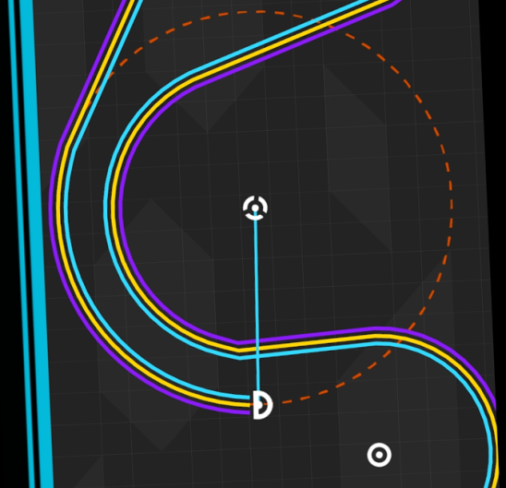

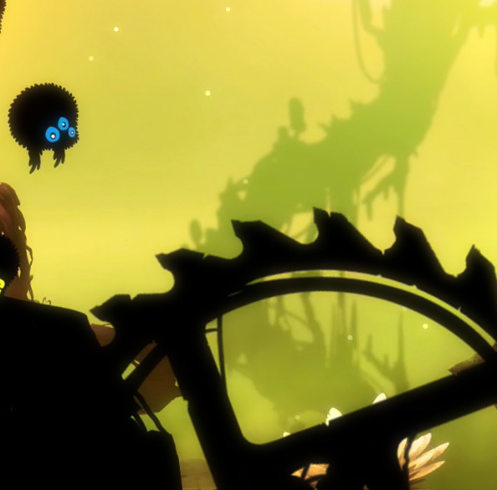

Research
One More Line
Tap as a toggle.
Badland / 2:
Uses single taps to counter gravity
Stack
Uses single taps based on timing
Dancing Line
Single taps to a rhythm
T

Slide 4
Overview of our game: The Battle Below
Submarine duel
Tapping dives
Releasing button fires torpedo
Destroy the opponent
Dodge various obstacles
C

Slide 5
Final Game Build
D

Slide 6
How did our game meet the brief
Our game is a 2D game for mobile platform
Uses a tap and hold mechanic for the simple control mechanic
Players play against each other simultaneously
Rules that are easy to understand
D

Slide 7
Feedback from gameplay playtesting
Main Menu required to direct the player to the game.
Players hiding below the screen.
The lack of artwork in the game
Hitboxes for the torpedo’s were too big
Instruction screen wording was misleading
C

Slide 8
Iterations from gameplay feedback
Included main menu and other menus
Included surface rocks to reduce players movement
Reduced hitbox size
De-cluttered text on menus
C

Slide 9
Feedback from previous presentation
Stop players from getting un-fair advantages
Game-testing
Spawning obstacles
Layers for the obstacles
Battleship depth charges
D

Slide 10

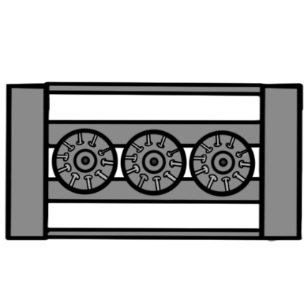
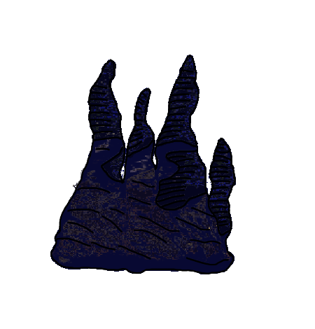
Iterations from presentation feedback
Seafloor damage
Gameplay-testing
Battleship depth charges
Obstacle layers
D

Slide 11
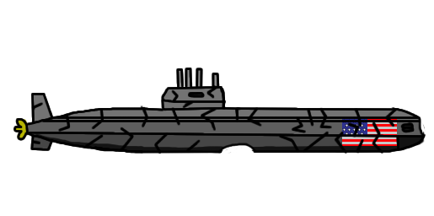
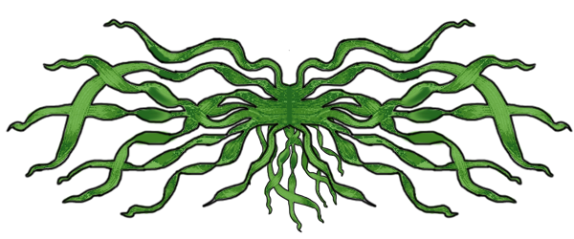
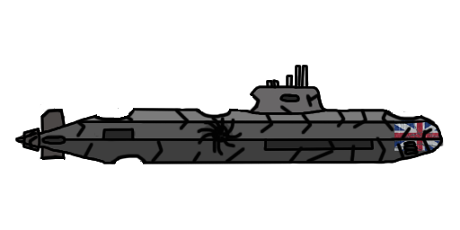
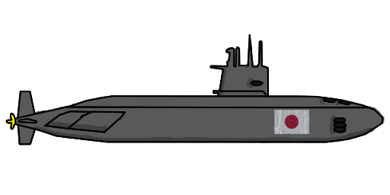
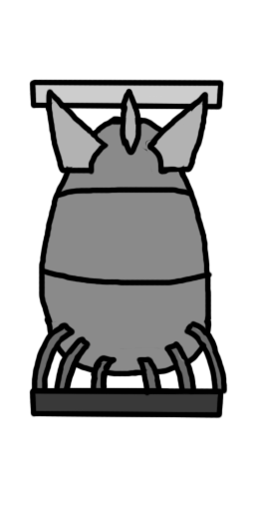
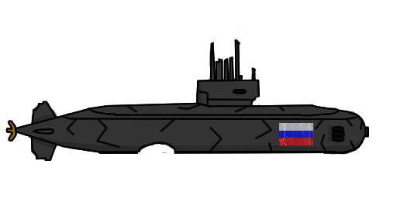

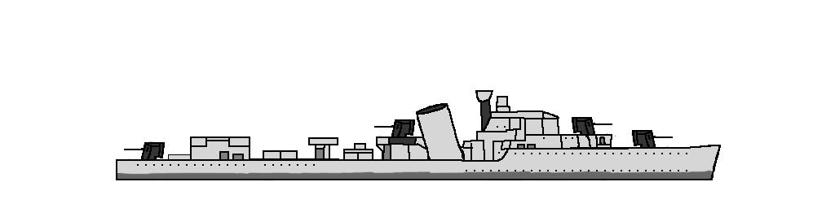
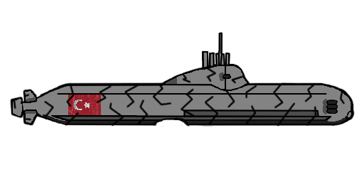
Artwork
T

Slide 12
Final Features
Multiple submarines with different statistics
Four obstacles (Depth Charges, Mines, Seaweed and Underwater rocks)
Several menu screens
Q

Slide 13
Future Development
Improved underwater explosion
Destroyed submarine visual effects
UI Health Bar
Gameplay Time Limit
Mobile Gameplay Testing
T

Slide 14
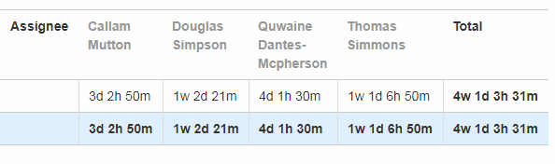
JIRA Hours Completed
Callam: 26hrs 50m
Quwaine: 33hrs 30m
Thomas: 54hrs 50m
Douglas: 56hrs 21m
Total: 171hrs 31m
Q

Slide 15
Any Questions

